Slide 1
Donkey Kong Replica
Gustavo Gutierrez

Slide 2
About Me
Born in L.A.
28 years old
Claims Supervisor at Flamingo Appliance Service
Appliance repair company
Hobby enthusiast

Slide 3
The Game
Donkey Kong Replica
Princess Peach saves Mario

Slide 4
Why I Chose this Game
Easy to learn how to play
Easy to code… or so I thought

Slide 5
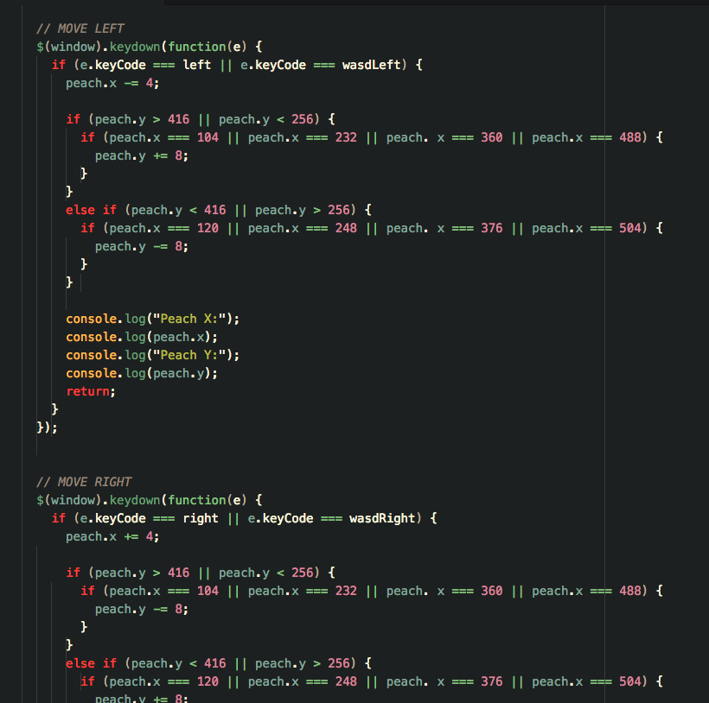
Problems…

Slide 6
